Slide 1

CA2 Part A AIML
By SongHan

Slide 2
Overview of workflow
Data Preprocessing
Transforming Time Series to Stationary
Tuning of the hyperparameters of models
Model Evaluation
Conclusion

Slide 3
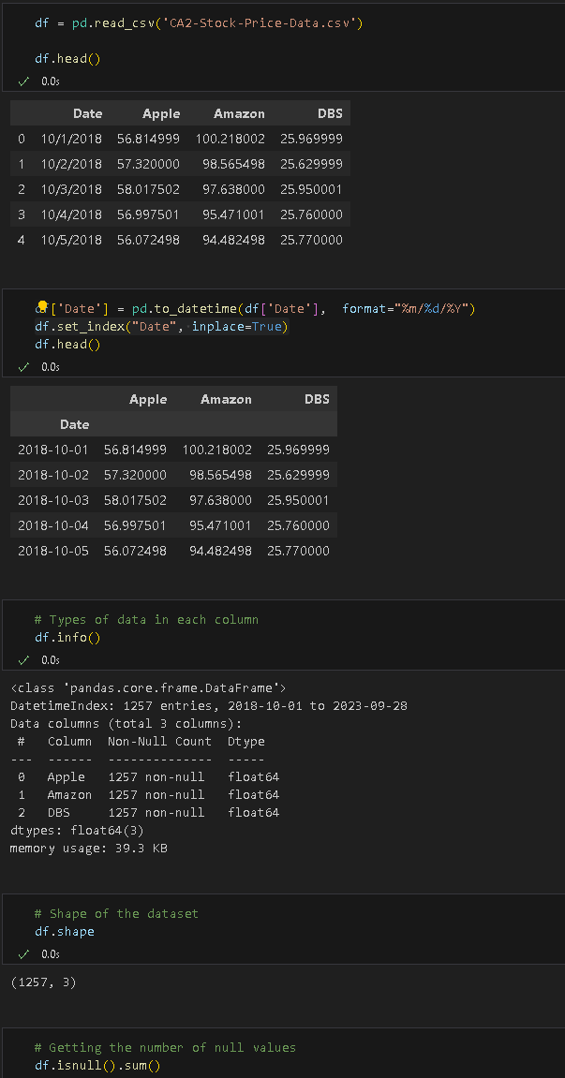
Importing the dataset
The dataset has 1257 rows, 3 columns
No missing values

Slide 4

Data Preprocessing

Slide 5
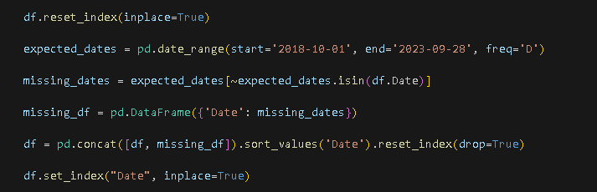
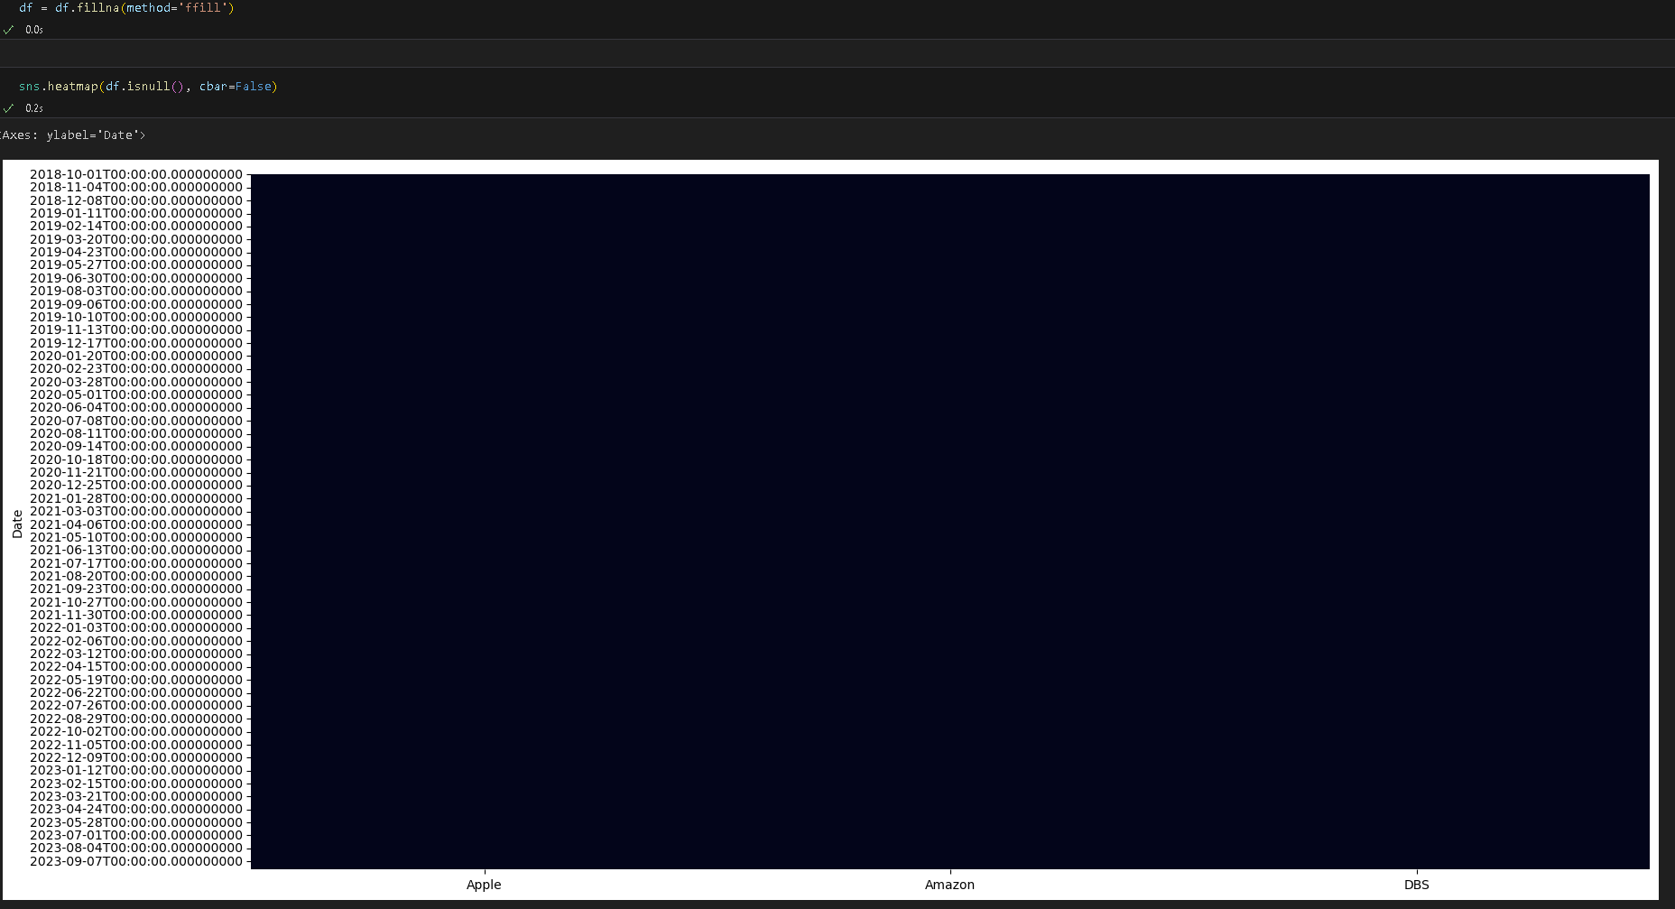
Handling missing dates
There were missing date intervals, so we will have to impute them in

Slide 6
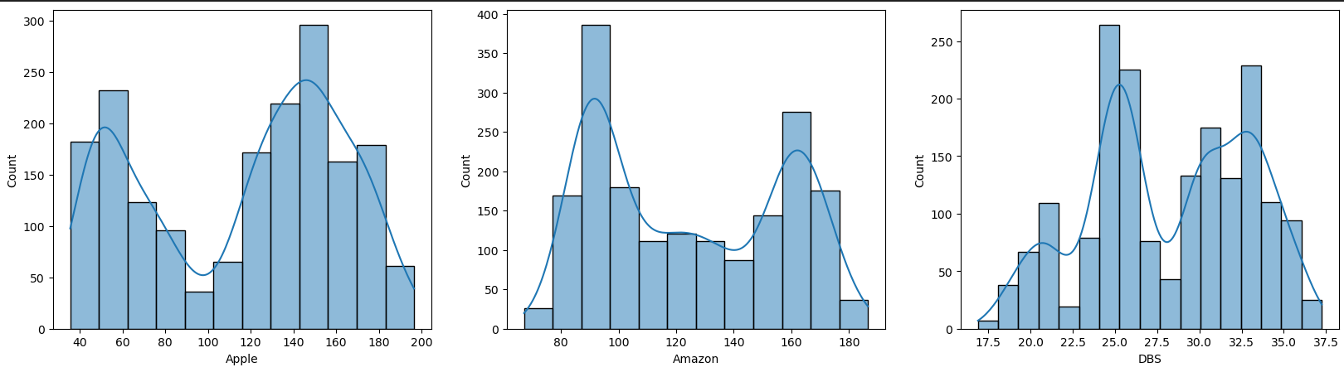
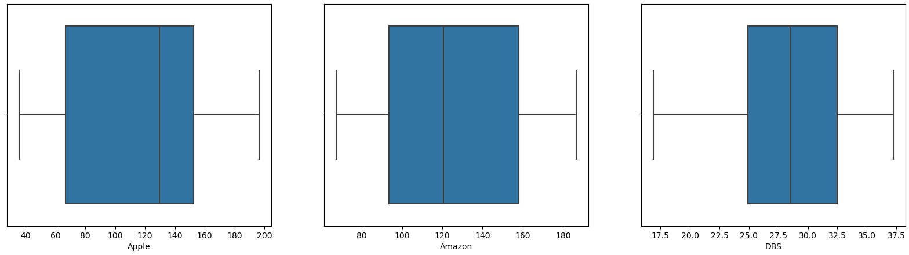
Univariate Analysis
There are no outliers

Slide 7
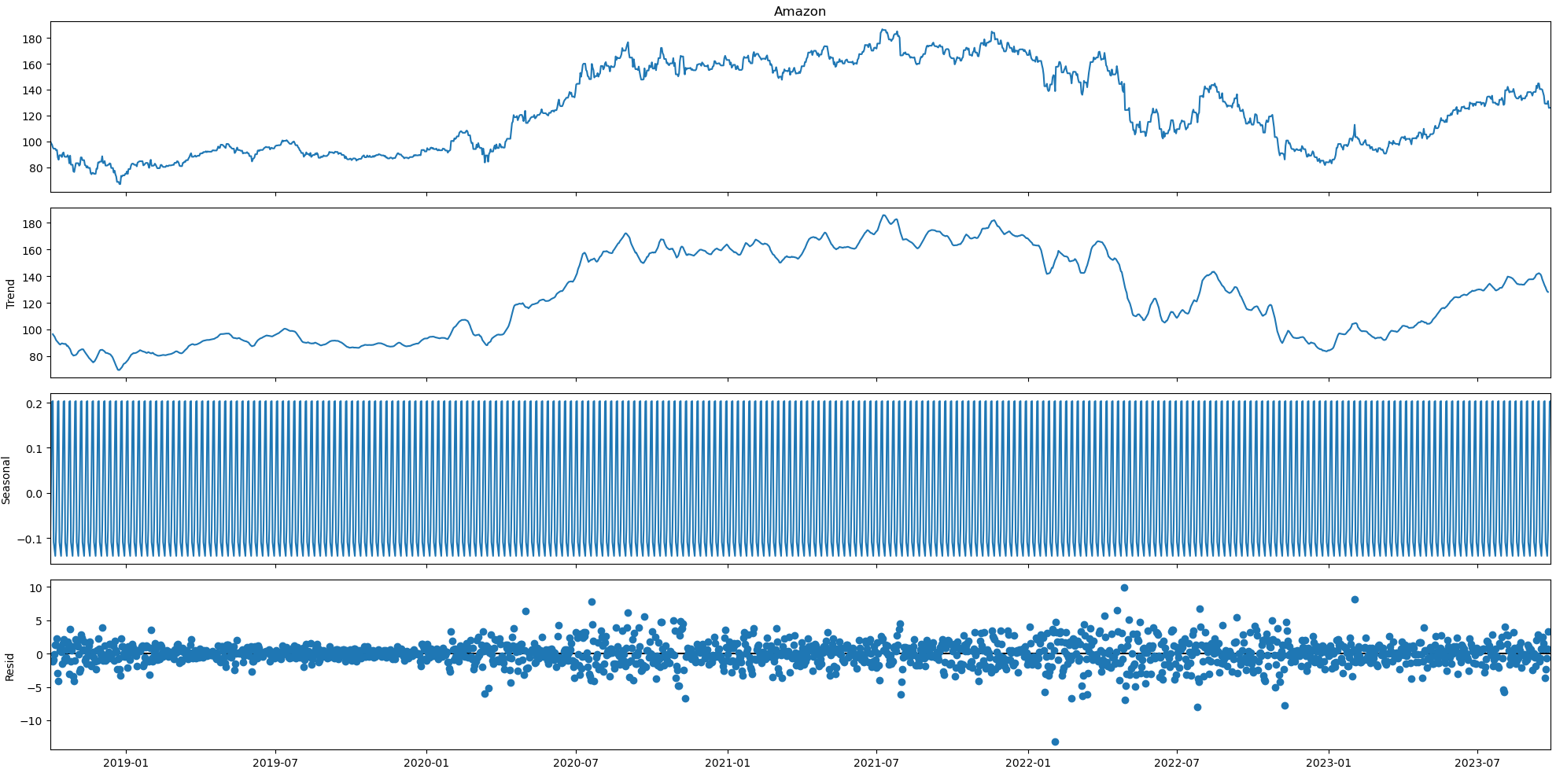
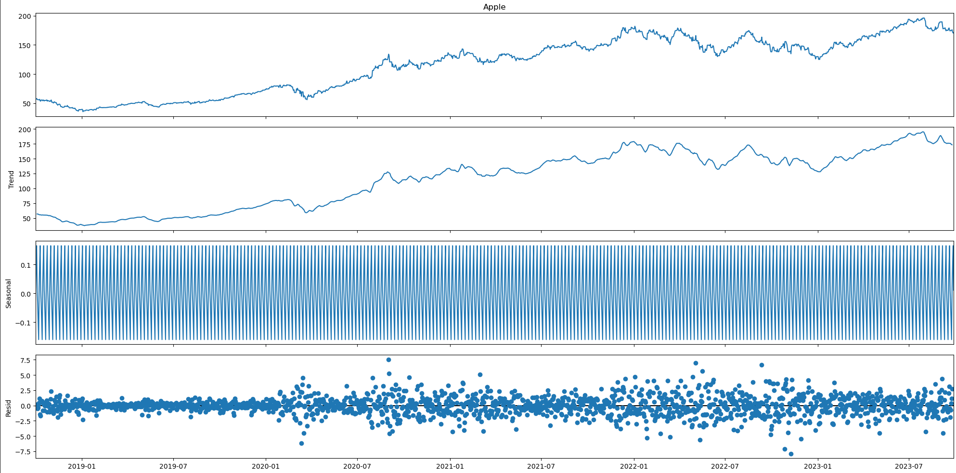
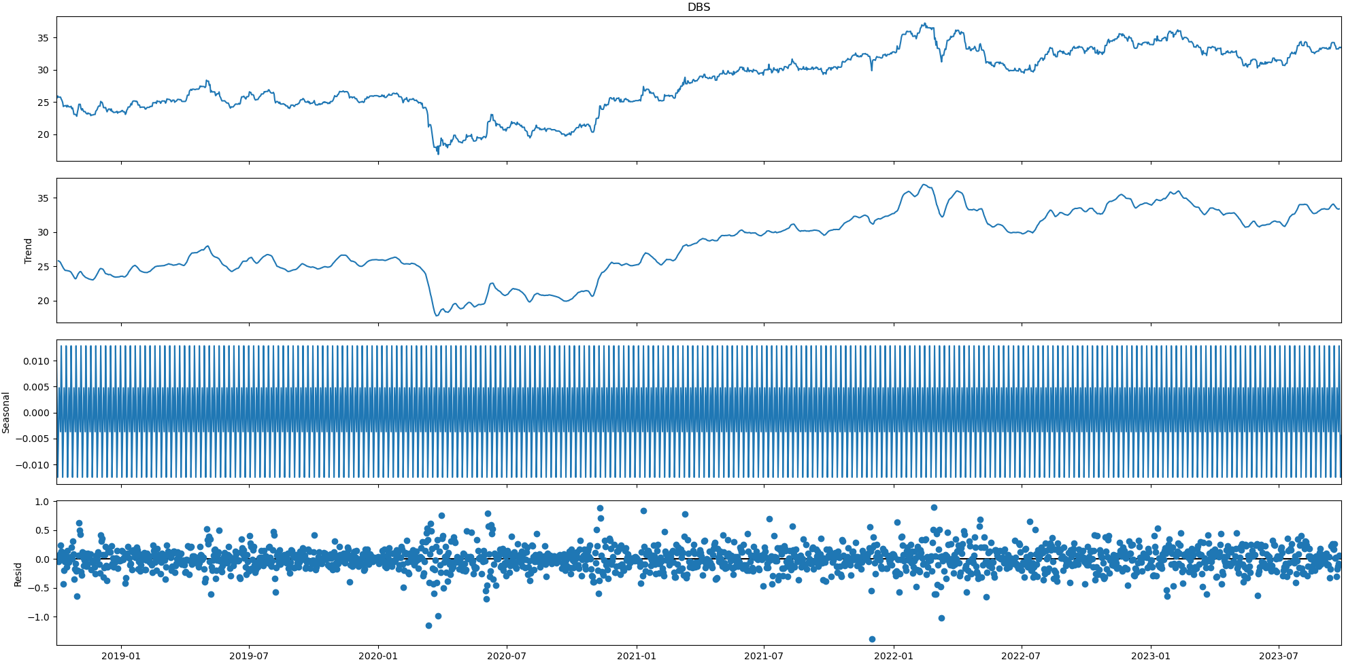
Time Series Decomposition
Decomposition to see the seasons and trend for each stock price in the dataset

Slide 8
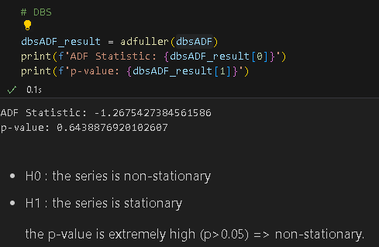
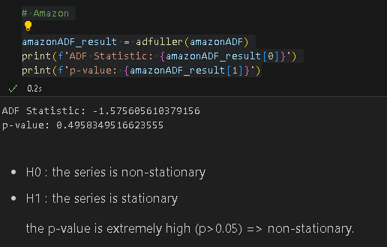
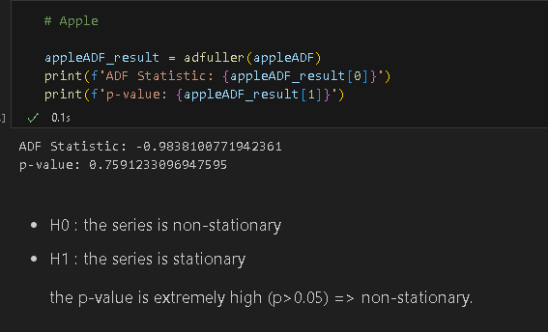
Stationary Test
All 3 stock prices are non-stationary, by ADF Test

Slide 9
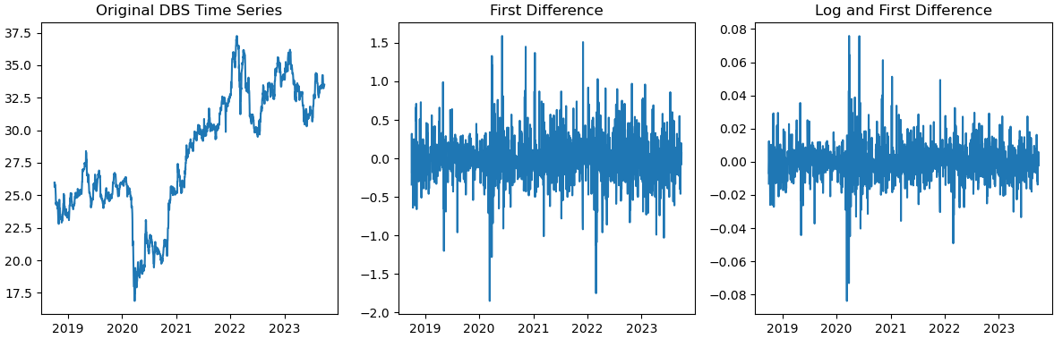
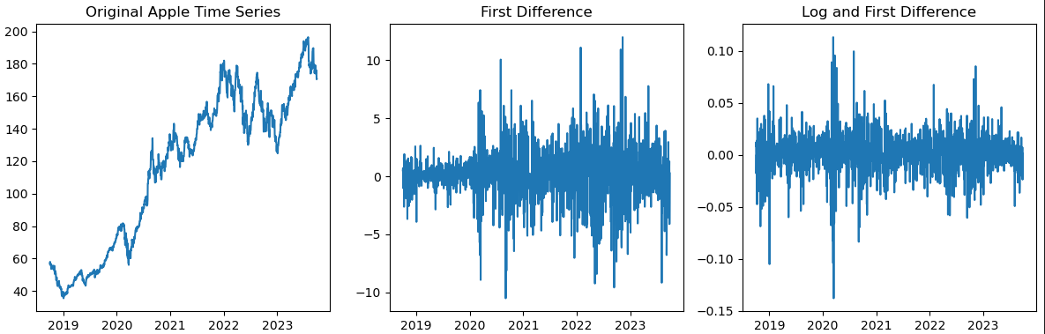
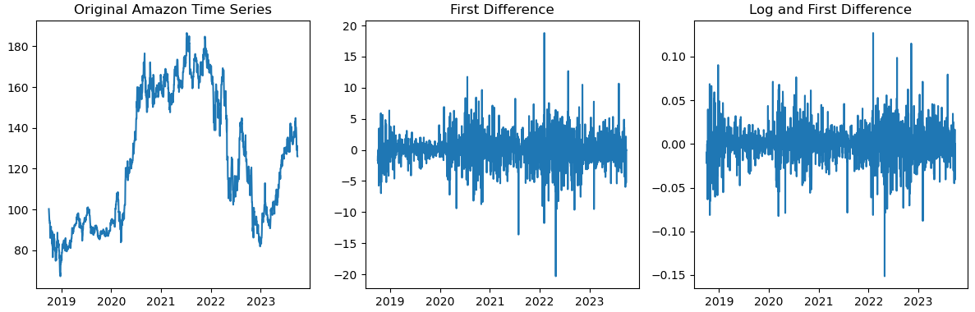
Differencing
We difference the stock price time series to make them stationary

Slide 10
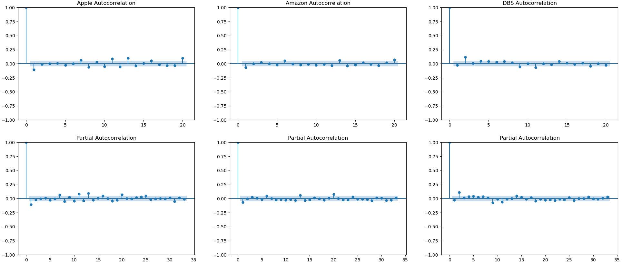
Autocorrelation Analysis
We note that there are some significant spikes in quite a few lags. This is indicative of autocorrelations, again underscoring that the time series is not white noise.

Slide 11

Model Selection

Slide 12
SARIMAX
Apple - SARIMAX (0, 0 , 1)(2, 1 ,1)[12]
DBS – SARIMAX (0, 0, 0)(0, 1, 1)[12]
Amazon – SARIMAX (1, 0, 0)(2, 2, 1)[12]

Slide 13
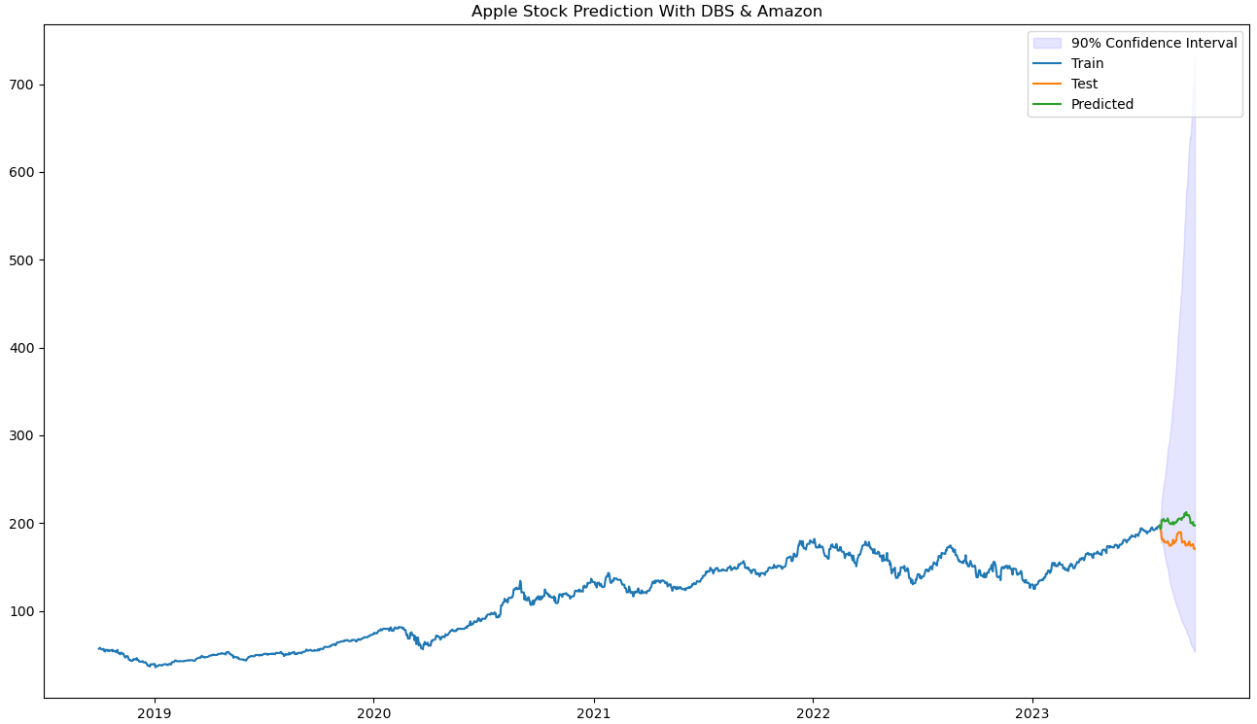
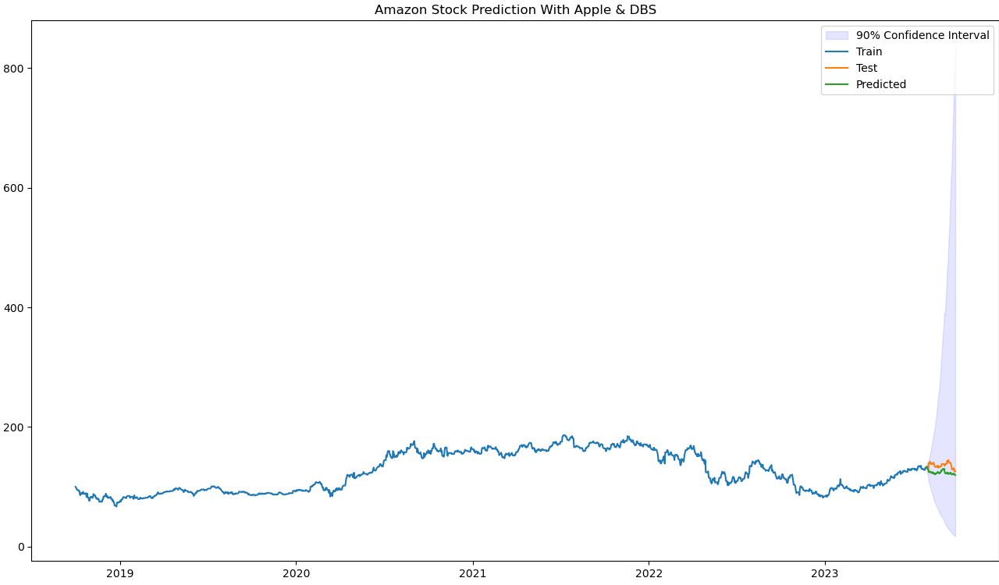
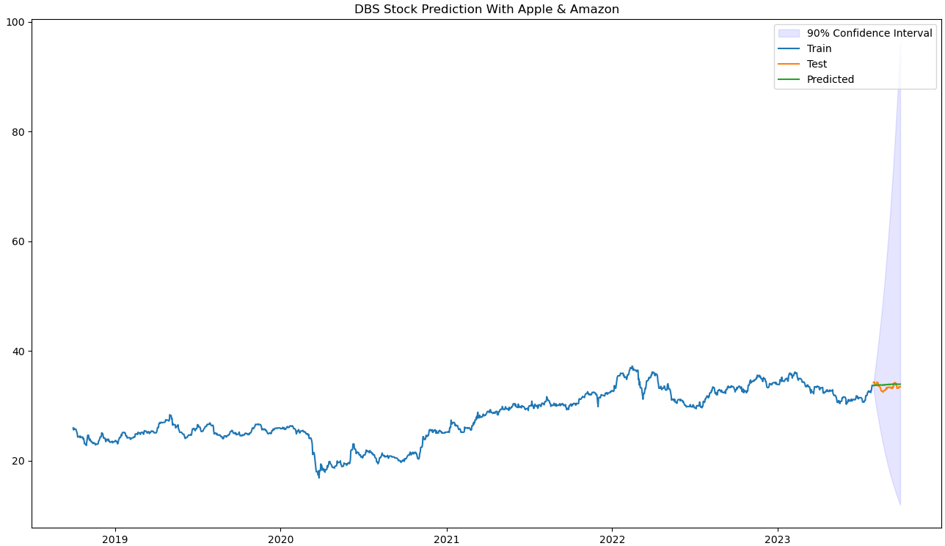
SARIMAX Model Forecasting

Slide 14
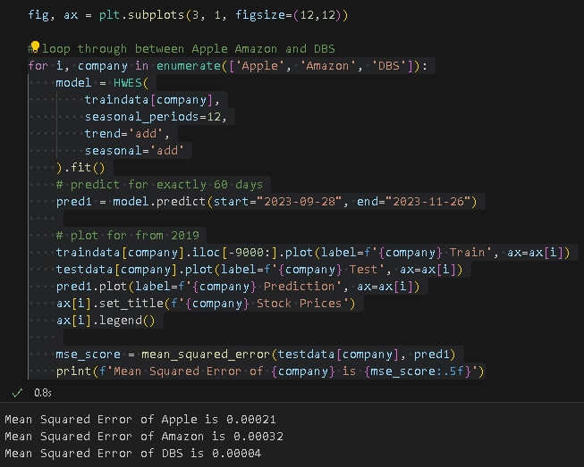
Holt-Winters Exponential Smoothing Model

Slide 15
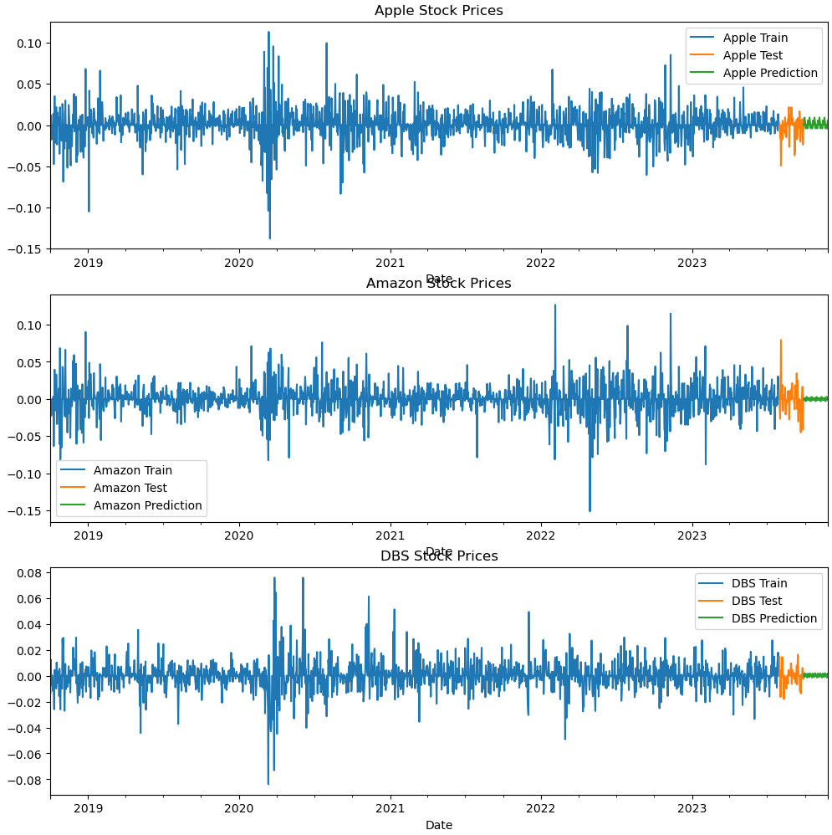
Holt-Winters Exponential Smoothing Forecasting

Slide 16
Final Model - Apple Stock
Holt-Winters Exponential Smoothing
Mean Squared Error of Apple is 0.00021

Slide 17
Final Model – Amazon Stock
Holt-Winters Exponential Smoothing
Mean Squared Error of Amazon is 0.00032

Slide 18
Final Model – DBS Stock
Holt-Winters Exponential Smoothing
Mean Squared Error of DBS is 0.00004

Slide 19
Conclusion
We went through preprocessing techniques such as imputing missing date values
We made sure that all the time series is stationary by differencing
We tuned the hyperparameters of the models
Scored the models based on Mean Squared Error
Found the best model for Each Stock

